Slide 1
Nuclear Power and Risks What it means for emerging technologies?
Karthik Ganesan
Research Fellow
Council on Energy, Environment and Water
8th Nuclear Conclave
New Delhi, 30 September 2016
© Council on Energy, Environment and Water, [insert year]

Slide 2
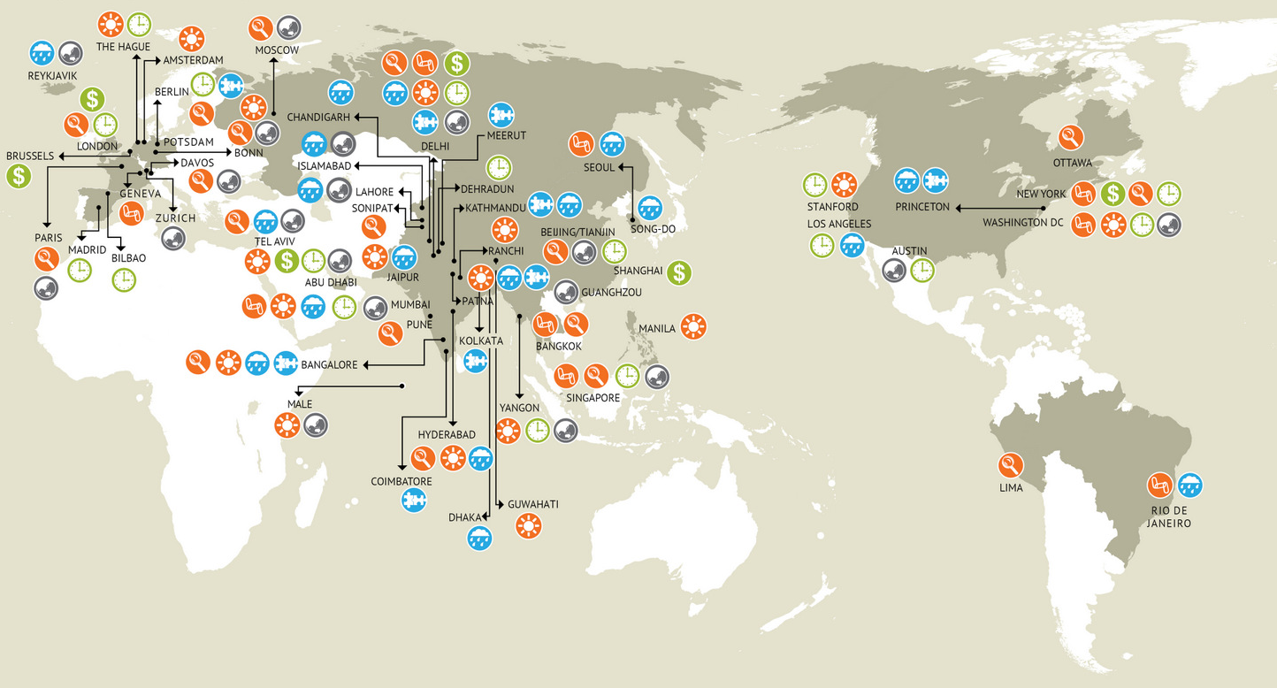
CEEW: one of India’s leading think-tanks

Slide 3
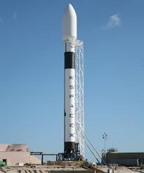
The rapid pace of technology development today

Slide 4
Technology development
First thermal power station (in 1880s) had an efficiency of 1.5% and ideas like FGD and SCR for pollutant removal did not become common place until 1970s and 1980s
First set of civilian nuclear reactor came up only in the 1950s and matured rapidly. Some of the most cost effective generation sources in the US today are the Gen II plants that came up
Technology development is inherently risky and has consequences – financial and otherwise, which we as a society must be willing to bear. We have done it in the past and it must continue if we are to realise some of the ambitious goals of climate change mitigation
SOURCE:

Slide 5
Risk Perception and Technology development
“While 62% of those surveyed supported the continued use of existing plants, 59% did not want to see new plants under construction “ (IAEA, 2005)
Where this distorted perception stems from is perhaps outlined by William Clark
“socially relevant risk is not uncertainty of outcome, or violence of event, or toxicity of substance, or anything of the sort. Rather, it is perceived inability to cope satisfactorily with the world around us”
If we are to make a marked difference to the way we generate energy today, increasing our risk appetite and embracing new possibilities is essential
We have done that for solar and wind in a big way. Perhaps they may not be able to satisfy all our needs, is conventional nuclear upto the challenge?

Slide 6
Small Modular Reactors
Early designs of the conventional nuclear reactor were “small” but perhaps not entirely modular as it was still custom built
They gyrated towards larger sizes on account of the economies of scale and the ability to recover larger costs from ‘fixed rate-paying’ customers in a regulated setting
This is changing and there are only few (possibly one) regulated utility in the US

Slide 7
What are some of the advantages of SMRs?
Current SMR designs incorporate innovative approaches to
Achieve design simplification
Modularity,
Passive safety features
Proliferation resistance
Speed of construction, and reduced financial risk
Their deployment strategy allows for an incremental approach, thus reducing up-front capital requirements and being more suitable to limited grid capacity
SMRs are positioned to penetrate markets not being served by the current fleet of reactors and thereby demonstrate the environmental (presumably reduced GHG emissions) and economic benefits of nuclear energy to a those countries that do not currently have a nuclear program (or only a test or lab reactor) but are interested in kick-starting a program outside the lab.

Slide 8
Challenges and opportunities of SMRs
Energy Access
Energy Security (?)
Sustainable development and climate change
Cost of delivered power and energy
Reduced Physical Risk (?)
““that scientists and technologists associated with the nuclear industry are building support for small modular reactors (SMRs) by advancing .. rhetorical visions imbued with elements of fantasy that cater to various social expectations” (Ramana and Sovacool, 2014)

Slide 9
Talking of physical risk
Reactor Name | Country | Power Output (MW) | No. of Reactors | Population within 30 km radius (million)
Lungmen | Taiwan | 2600 | 2 | 1.5
Doel | Belgium | 2910 | 4 | 1.51
Biblis | Germany | 2407 | 2 | 1.51
Pickering | Canada | 3094 | 8 | 2.2
Lingao | China | 3876 | 4 | 3.11
Guangdong | China | 1888 | 2 | 3.25
Kori | S.Korea | 3227 | 4 | 3.41
Chin Shan | Taiwan | 1208 | 2 | 4.69
Kuosheng | Taiwan | 1933 | 2 | 5.45

Slide 10
What course of action?
Important to be transparent about the costs that nuclear installations incur
Important to ensure that the stakeholders in the vicinity of a chosen site have been apprised of the real risks and rewards
Think of novel financial instruments for nuclear and address the issue of liability clearly to allow for the flow of funding
India must be part of the global effort to evolve new designs – there are restrictions today, but we must be prepared to embrace these new designs as and when they roll out

